Slide 1
How to train a tree

Slide 2


Slide 3
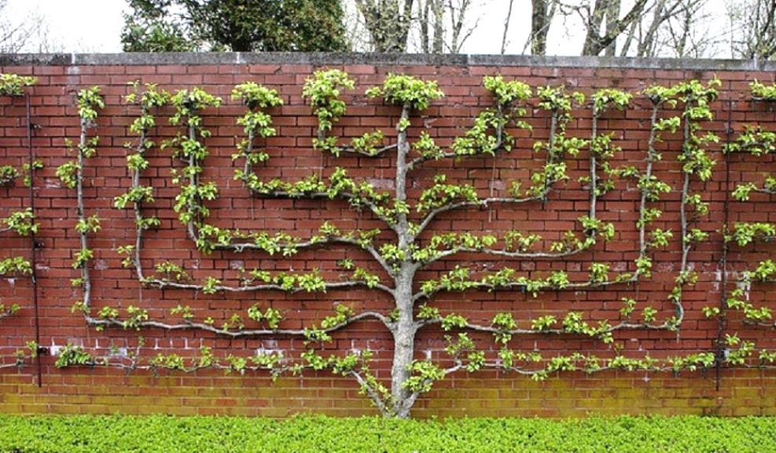

Slide 4
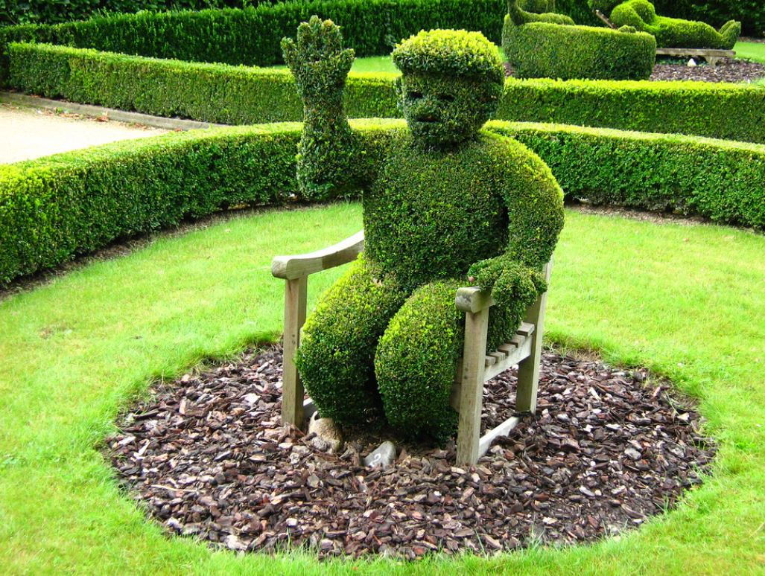

Slide 5
Problem
Accumulating vast amounts of data
Many analytical tools available
Difficult to imagine writing enough software to understand all this data
Not extracting all the value in this data

Slide 6
Machine Learning
An approach for designing algorithms that infer unknown information from known data
Software that learns useful algorithms, by experience with data, rather than being tediously coded by a human
Babies and balls

Slide 7
Machine Learning
Machine learning is a collection of methods and approaches
Makes use of statistics and mathematics. Sometimes described as AI; just code and algorithms
Training a decision tree is one of the simplest machine learning approaches

Slide 8
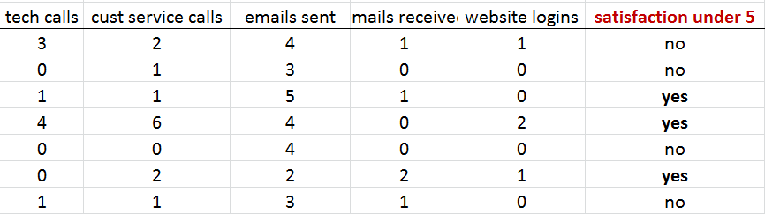
Example 1
Features or classes
Instances (m)
Outcome or response (usually binary)

Slide 9
Example 1
Goal: Given a these inputs:
Predict: will the outcome (satisfaction) under be 5?

Slide 10
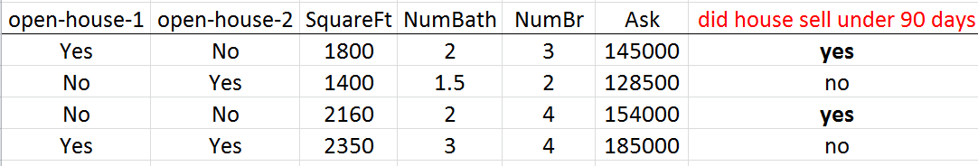
Example 2

Slide 11
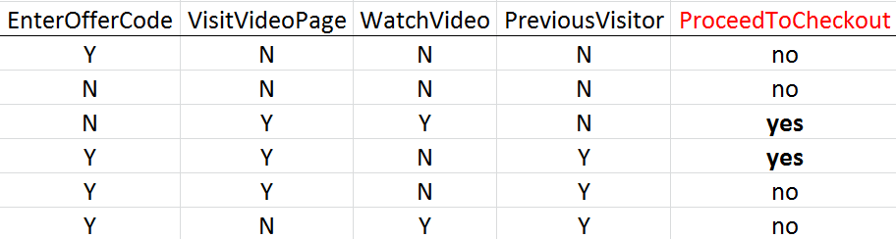
Example 3
More complex examples…

Slide 12
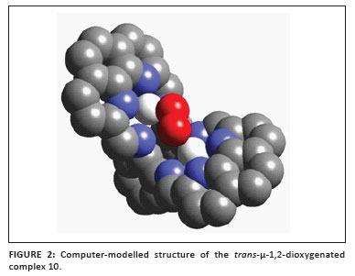
Classifying enzymes based on properties

Slide 13
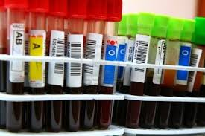
Learning from large experimental studies

Slide 14
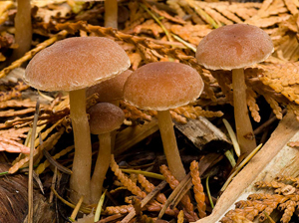
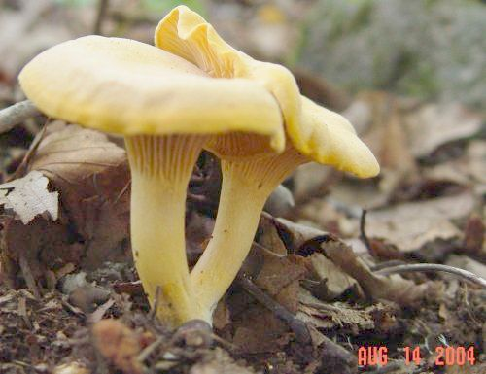
Which one would you eat?

Slide 15
Steps in machine learning approach
Gather data set
Divide the data:
80% for training data
20% for testing learned algorithm (model)
Train a model using the training data set
Test the model using the test data set
Evaluate / tweak / Iterate
Model in this case is a Decision Tree
Many other models: regression, neural nets, etc

Slide 16
Why is machine learning gaining traction now?
Large quantities of data being stored
Large quantities of data being made available
Growing set of powerful tools and code libraries for machine learning
Highly scalable computing power
There is value in ability to make predictions

Slide 17
Common applications
Spam filtering
Speech recognition
Handwriting recognition
Sentiment analysis
Recommendations
Text classification
Machine translation
Video of Peter Norvig – Google, translation, bag of words
https://www.youtube.com/watch?v=T1O3ikmTEdA

Slide 18
Decision Tree
Employment History?
No
Yes
Car Loan?
Previous Mortgage?
No
Yes
No
Yes
No
Yes
No
Yes

Slide 19
How to construct?
Manually – to define business rules or policy
Manually – to think through program logic

Slide 20
How to construct?
Manually – to define business rules or policy
Manually – to think through program logic
Automatically – based on a set of data

Slide 21
Entropy
A measure of uncertainty
All data the same
Entropy = 0,
uncertainty is low
The more random the data, the higher the entropy; the higher the uncertainty
Entropy is primary calculation used when training a decision tree
Information theory, Bayes Theorem

Slide 22
Get a feel for Entropy in Excel

Slide 23
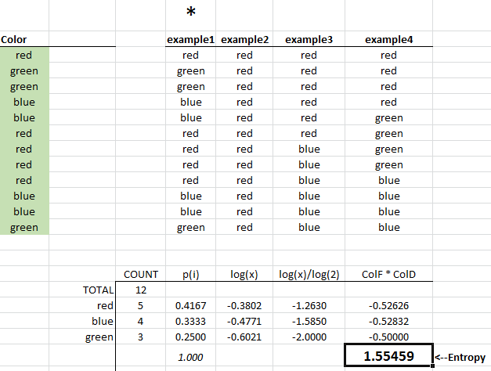

Slide 24
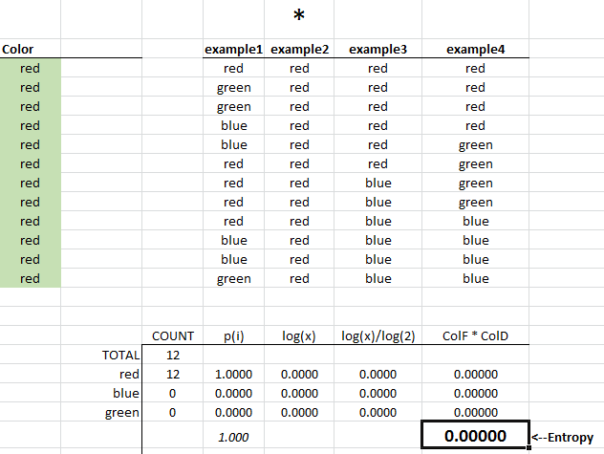

Slide 25
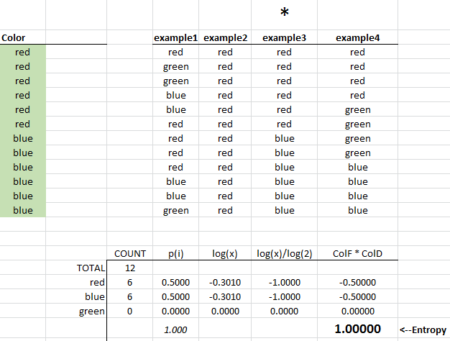

Slide 26
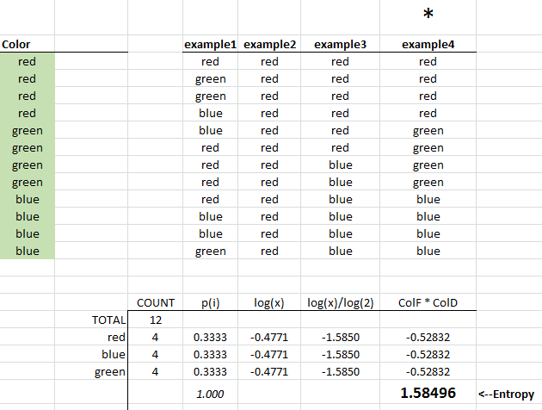

Slide 27
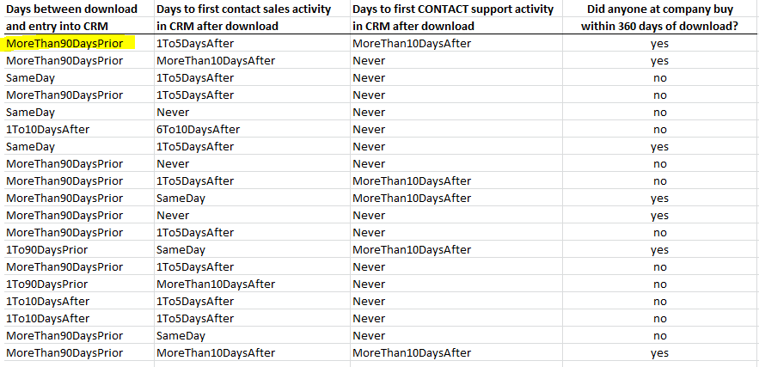
Real Data
Data massaged into
Discrete buckets
Known outcomes
For training
4100 rows training data
1114 rows of test data
Features or classes

Slide 28
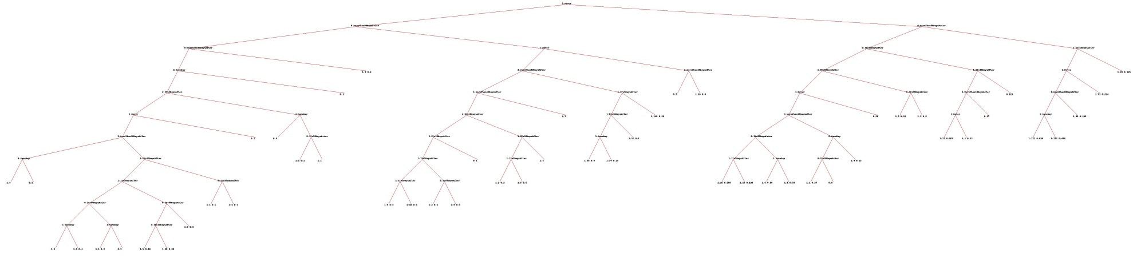
Decision Tree

Slide 29
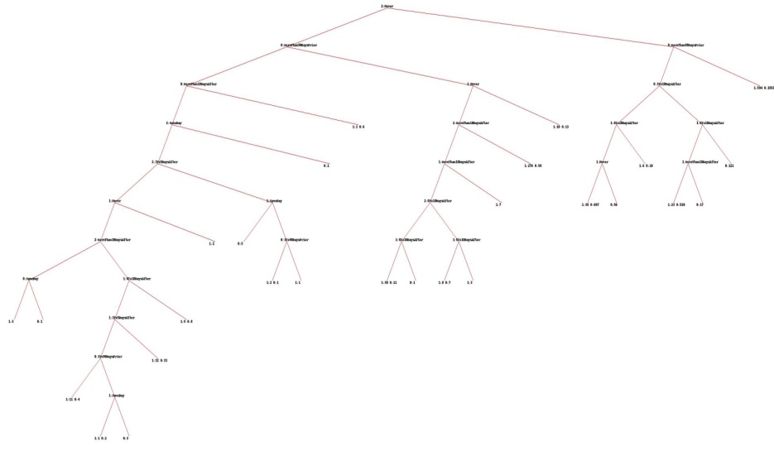
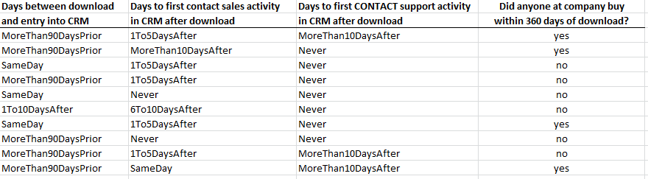
The first split
Days from download
To first support activity
Contains: Never
No
Yes

Slide 30
Follow 1st split down “yes” side
Days between download
And entry into CRM
Contains:
MoreThan90DaysPrior
No
Yes

Slide 31
End or “leaf” of 1st split going down the right side
594 did purchase
1553 did not

Slide 32
Leaf with most positive outcomes

Slide 33
Path leading to 2nd most positive outcomes

Slide 34
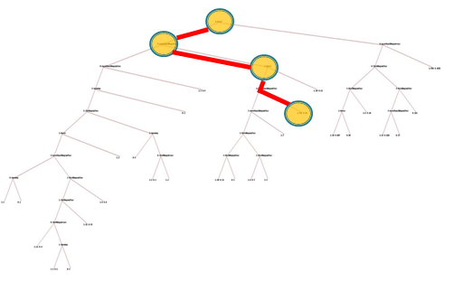
Path leading to 2nd most positive outcomes
Days to first contact SUPPORT activity after download contains something
other than Never.
Days between download and entry into CRM contains
MoreThan90DaysPrior.
Days to first contact SALES activity after download contains something other than Never
Days to first contact support activity after download contains
MoreThan10DaysAfter
276 did purchase
59 did not

Slide 35
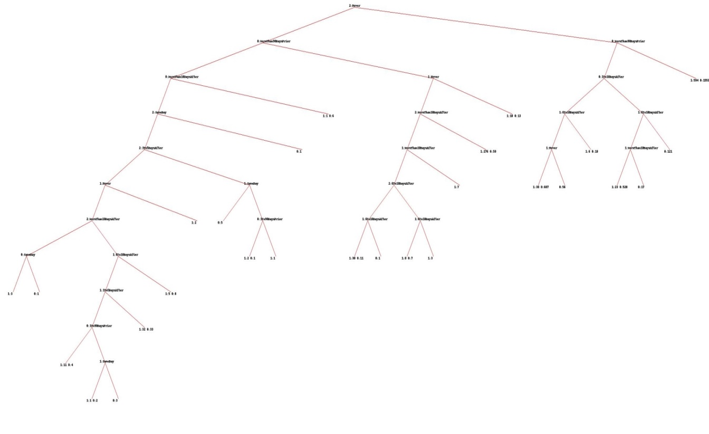
Explore positive and negative paths

Slide 36
Pruning a decision tree

Slide 37
Results
Not accurate on the first try…took lots of experimenting – started with more columns and more categories in each column. Had 2 columns representing same data…low accuracy.
Important to randomize or shuffle the data
Had 3 workers in the system – guess on 10 random rows – average correct = 47%
To be fair…the workers did not get to see all the training data…only their 10 records; they were at a disadvantage - to the model.
Model predicted 79% correct on test data

Slide 38
What does the code look like?
Python, version 2.7
Free, interpreted, easy to try things
Code is from chapter 7 of “Programming Collective intelligence”

Slide 39
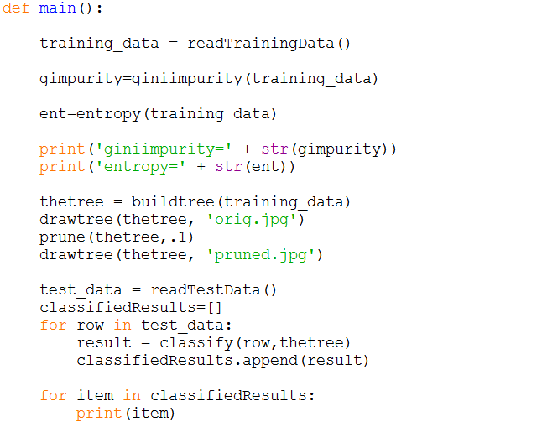

Slide 40
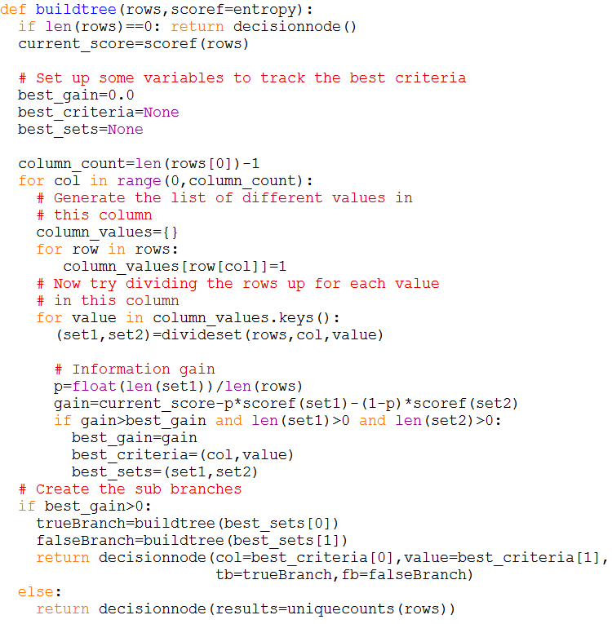

Slide 41
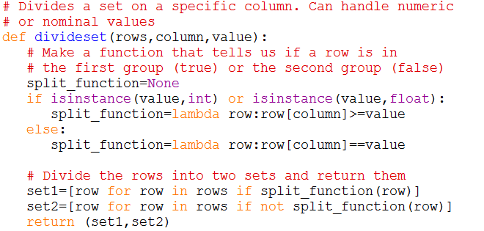

Slide 42
Problems
Tree can be huge
Tree can be over-fitted – too many instances have their own path
Tree might not be accurate on test data
Approach is sensitive to noise
Reconsider your choice of features
Categorize continuous variables into fewer buckets

Slide 43
How does it help?
Deploy resources on “good paths”
Understand why on the “bad paths”
Asses beliefs of workers in the system
Improve system understanding

Slide 44
Kaggle
Website – data science competitions
Holds competitions for machine learning
Pays winners, non-domain experts often win
Talk by Jeremy Howard
“Getting In Shape for the Sport of Data Science”
Example competitions:
Bike sharing demand, Digit recognizer, facial key point detection, West Nile Virus prediction

Slide 45
Andrew Ng
Stanford Professor, Google Researcher, Coursera founder – now working in China at Biadu as chief data scientist
Free on-online course – Machine Learning
Offered through Coursera
Shorter videos on YouTube
Has contributed to significant projects

Slide 46
Opportunity?
Big companies have a good start
New (and old) algorithms used in a new way and in a new space
Yes! – feels like a huge opportunity to me.
Plenty of opportunity for a small firm to wrap up a nice experience - in an approachable app for everyday users.

Slide 47
Run Python (maybe)

Slide 48
Resources
Book – Programming Collective Intelligence – Toby Segaran
Book – Machine Learning, The Art and Science of Algorithms that Make Sense of Data – Peter Flach
Pthyon code for experiment in Chapter 7 of first book – available on line

Slide 49
steve_daum@hotmail.com

